Slide 1
Computer Systems, Data Structures & Data Management
Markos Vassilis
Mediterranean College
Week 07

Slide 2
Primes (Warm Up)

Slide 3
Primes
A positive integer is said to be prime if it is > 1 and its only divisors are 1 and itself.
  Some primes: 2, 3, 5, 7, 11, 13, 17, 19, …
  Some composites (non-primes): 4, 6, 8, 9, 10, 12, 14, 15, 16, …
There are infinitely many prime numbers.
There is no known formula to generate them, yet.
So, we have to check for each number whether its prime or not (well, not exactly, but, something like that).
Can you think of a way to check whether a number is prime?

Slide 4
Primal Fears…
Of course you can!
Open ‘complexity_cpp > complexity_testing.cpp’.
What does isPrime1() do?
  Can you think of something better?
What does isPrime2() do?
  Can you think of something better?
What does isPrime3() do?
  Can you think of something better?
  Homework!

Slide 5
Primal Checks
Compile and execute ‘complexity_cpp > complexity_testing.cpp’.
What did it print?
Explain the results.
How much better is isPrime3() from the rest?
So, picking the right algorithm really matters…

Slide 6
Sorting (Actual Fun)

Slide 7
Sorting
It is nice to have things in place. Consider the following array:
arr = [3, 6, 1, 7, 9, 0, 2];
Evidently, arr is not sorted in any meaningful way. How can we put thing in increasing order (in a systematic way).
[Take some time to devise a sorting algorithm that can work for arbitrary size arrays, not just for arr.]

Slide 8
Bubbles. I want more bubbles.
3
6
1
7
9
0
2
3 < 6 → Things in place!
3
6
1
7
9
0
2
6 > 1 → Things not in place!
3
1
6
7
9
0
2
1 < 6 → Swap!
3
1
6
7
9
0
2
6 < 7 → Things in place!

Slide 9
Bubbles. I want more bubbles.
3
1
6
7
9
0
2
7 < 9 → Things in place!
3
1
6
7
9
0
2
9 > 0 → Things not in place!
3
1
6
7
0
9
2
0 < 9 → Swap!
3
1
6
7
0
9
2
9 > 2 → Things not in place!

Slide 10
Bubbles. I want more bubbles.
3
1
6
7
0
2
9
2 < 9 → Swap!
3
1
6
7
0
2
9
3 > 1 → Things not in place!
1
3
6
7
0
2
9
1 < 3 → Swap!
1
3
6
7
0
2
9
3 < 6 → Things in place!

Slide 11
Bubbles. I want more bubbles.
1
3
6
7
0
2
9
6 < 7 → Things in place!
1
3
6
7
0
2
9
7 > 0 → Things not in place!
1
3
6
0
7
2
9
0 < 7 → Swap!
1
3
6
0
7
2
9
7 > 2 → Things not in place!

Slide 12
Bubbles. I want more bubbles.
1
3
6
0
2
7
9
2 < 7 → Swap!
1
3
6
0
2
7
9
1 < 3 → Things in place!
1
3
6
0
2
7
9
3 < 6 → Things in place!
1
3
6
0
2
7
9
6 > 0 → Things not in place!

Slide 13
Bubbles. I want more bubbles.
1
3
0
6
2
7
9
0 < 6 → Swap!
1
3
0
6
2
7
9
6 > 2 → Things not in place!
1
3
0
2
6
7
9
2 < 6 → Swap!
1
3
0
2
6
7
9
1 < 3 → Things in place!

Slide 14
Bubbles. I want more bubbles.
1
3
0
2
6
7
9
3 > 0 → Things not in place!
1
0
3
2
6
7
9
0 < 3 → Swap!
1
0
3
2
6
7
9
3 > 2 → Things not in place!
1
0
2
3
6
7
9
2 < 3 → Swap!

Slide 15
Bubbles. I want more bubbles.
1
0
2
3
6
7
9
1 > 0 → Things not in place!
0
1
2
3
6
7
9
0 < 1 → Swap!
0
1
2
3
6
7
9
1 > 2 → Things in place!
0
1
2
3
6
7
9
0 < 1 → Things in place!

Slide 16
Bubbles. I want more bubbles.
0
1
2
3
6
7
9
Done!
Really slow, isn’t it?
How “much” would this take to sort one million integers?
As Obama has said, “Bubble sort is the wrong way to go [when it comes to sorting one million integers]”.
[source]
Can you think of something faster?

Slide 17
Divide and Conquer
3
6
1
7
9
0
2
Start with the same list…
3
6
1
7
9
0
2
Split things to unitary blocks…
3
6
1
7
9
0
2
Merge the first two, respecting order…
3
6
1
7
9
0
2
Merge the next two, respecting order…

Slide 18
Divide and Conquer
3
6
1
7
0
9
2
Merge the next two, respecting order…
1
3
6
7
0
9
2
Merge the next two, respecting order…
1
3
6
7
0
2
9
Merge the next two, respecting order…

Slide 19
Divide and Conquer
1
3
6
7
0
2
9
[Repeating from previous slide]
0
1
2
3
6
7
9
Merge the next two, respecting order…
Is this any better?
How much time does it take to merge lists respecting their order?
Let’s compare them…

Slide 20
Measuring time complexity
Open ‘sorting_cpp/sorting.cpp’.
Try to make some sense of the purpose of this file.
[Try a bit more…]
Okay, now, compile and run it!
What was the output?
Run plotter.py (in the same folder).
What does the plot say?

Slide 21
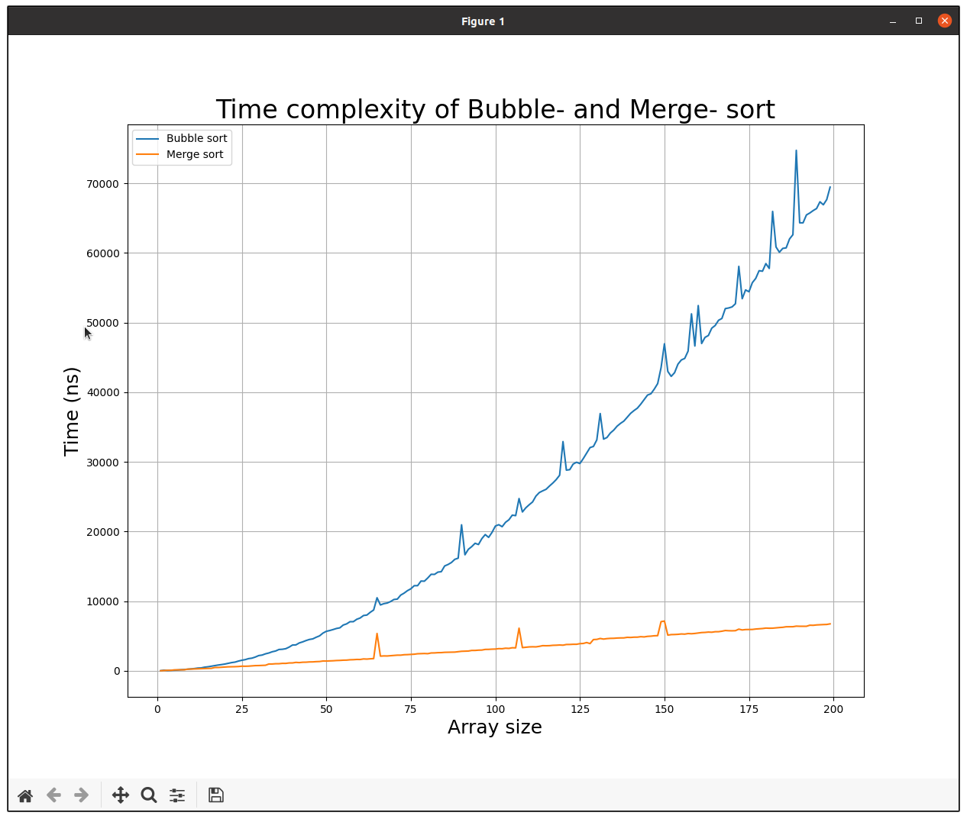
Hopefully, what you see looks like that…

Slide 22
So…?
Which algorithm do you think is better?
Why?
What are some problems with comparing algorithms this way?
  My machine might be worse / better than yours.
  Random noise from other processes running at the same time.
  Bad luck might influence execution duration - what if the lists we have generated were inappropriate for bubble sort?
  With statistics you can never be really-really sure…

Slide 23
Bubbles and Complexity
In short, Bubble-sort looks like this:
swapped = True, j = 1
while swapped:
for i = 0,1,..., n - j:
if arr[i] > arr[i + 1]:
swap arr[i] and arr[i + 1]
swapped = True
j++;
arr has been sorted!
What about (worst-case) complexity?

Slide 24
Bubbles and Complexity
In short, Bubble-sort looks like this:
swapped = True, j = 1
while swapped: ← This will be executed at most n-1 times
for i = 0,1,..., n - j: ← This is roughly n iterations
if arr[i] > arr[i + 1]:
swap arr[i] and arr[i + 1]
swapped = True
j++;
arr has been sorted!
Worst case complexity: O(n x (n-1)) = O(n^2)
Elementary
Operation

Slide 25
Merging and Complexity
In short, Merge-sort looks like this:
n = len(arr)
for i = 0, 1, …, log(len(arr)):
for j = 0, 1, …, n:
left = arr[j : j+2^i]
right = arr[j+2^i : j+2^(i+1)]
merge(left, right)
n = n / 2
arr has been sorted!
What about (worst-case) complexity?

Slide 26
Merging and Complexity
In short, Merge-sort looks like this:
n = len(arr)
for i = 0, 1, …, log(len(arr)): ← This is repeated log(n) times
for j = 0, 1, …, n: ← Don’t fall for this!
left = arr[j : j+2^i]
right = arr[j+2^i : j+2^(i+1)]
merge(left, right) ← len(left) + len(right) EO
n = n / 2 which means n EO per iteration.
arr has been sorted!
Worst case complexity: O(nlog(n))

Slide 27
Why merge log(n) times?
Consider a list of length 8 = 2^3 (just for convenience). Once broken into pieces of length == 1, you have 8 tiny lists of one element each.
Every time you merge you are left with exactly half (±1) tiny lists (of roughly double size)
So, after how many “merge runs” will you be left with just one (the initial) list?
8 tiny lists → 4 tiny lists → 2 tiny lists → 1 large list.
At each step you divide by two, so, essentially, you are looking for the number of consecutive divisions by 2 required to reach 1, starting from 8.
Reading this right to left, we can count the number of multiplications by 2 required to reach 8 from 1, i.e., if m is that number, we want an m such that:
2^m == 8.
This is exactly the definition of log(8) (log = logarithm base 2)
Substitute 8 with n and you get (roughly) m = log(n).

Slide 28
Insertion Sort
Consider the following sorting algorithm:
i = 1
while i < len(arr):
j = i
while j > 0 and arr[j] < arr[j - 1]:
swap arr[j] and arr[j-1]
j--
i++
arr has been sorted!
What about worst-case complexity?

Slide 29
Insertion Sort
Consider the following sorting algorithm:
i = 1
while i < len(arr): ← This is repeated n times
j = i
while j > 0 and arr[j] < arr[j - 1]: ← At most n - 1 times
swap arr[j] and arr[j-1]
j--
i++
arr has been sorted!
Worst-case complexity: O(n x (n-1)) = O(n^2)

Slide 30
Bogus – Bogus
Consider the following sorting algorithm:
while arr is not sorted:
randomly shuffle arr
return arr
arr is sorted!
What about worst-case time complexity?

Slide 31
Bogus – Bogus
Consider the following sorting algorithm:
while arr is not sorted: ← There are n! different permutations
randomly shuffle arr ← Each shuffling takes roughly O(n)
return arr
arr is sorted!
In the worst case, arr will never be shuffled correctly, so infinite time!
On average, O((n-1)n!) (n! = 1·2·3·…·n), so, much (much) slower than everything we have seen so far!

Slide 32
Fibonacci Numbers

Slide 33
Fibonacci numbers
A really popular sequence of numbers (Wikipedia)
The first terms of the sequence are: 0, 1, 1, 2, 3, 5, 8, 13, 21, 34, 55, 89, 144, …
f(0) = 0, f(1) = 1.
f(2) = f(1) + f(0) = 1.
f(3) = f(2) + f(1) = 3.
…
Each term (except for the first two) is the sum of the two terms right before it.
f(n) = f(n-1) + f(n-2).

Slide 34
One way to compute them all
Consider the following python script (‘fibonacci/fib.py’). How does it work? How long will it take to execute to compute the n-th Fibonacci number? Any better ideas?
def fib(n):
result = 0
f = [n]
while f:
current = f.pop()
if current in [0, 1]:
result += current
else:
f += [current - 1, current - 2]
return result

Slide 35
An Example
f | current | result | in [0,1]?
[3] | — | 0 | —
[] | 3 | 0 | False
[2, 1] | — | 0 | —
[2] | 1 | 1 | True
[] | 2 | 1 | False
[1,0] | — | 1 | —
[1] | 0 | 1 | True
[] | 1 | 2 | True
def fib(n):
result = 0
f = [n]
while f:
current = f.pop()
if current in [0, 1]:
result += current
else:
f += [current - 1, current - 2]
return result
Whenever we encounter anything other than 0 or 1, we add two to f…

Slide 36
An Example (cont’d)
For n = 8:
[8]
[8, 7, 6]
[8, 7, 5, 4]
[8, 7, 5, 3, 2]
[8, 7, 5, 3, 1, 0]
[8, 7, 5, 3, 1]
[8, 7, 5, 3]
[8, 7, 5, 2, 1]
[8, 7, 5, 2, 1]
[8, 7, 5, 2]
[8, 7, 5, 1, 0]
[8, 7, 5, 1]
[8, 7, 5]
[8, 7, 4, 3]
[8, 7, 3, 2, 1]
[8, 7, 3, 2]
[8, 7, 3, 1, 0]
[8, 7, 3, 1]
[8, 7, 3]
[8, 7, 2, 1]
[8, 7, 2]
[8, 7, 1, 0]
[8, 7, 1]
[8, 7]
[8, 7, 6, 5]
[8, 7, 6, 4, 3]
[8, 7, 6, 3, 2, 1]
[8, 7, 6, 3, 2]
[8, 7, 6, 3, 1, 0]
[8, 7, 6, 3, 1]
[8, 7, 6, 3]
Why 2 appears more than once?
Why all numbers (will) appear more than once?
Because this is a silly way to compute the 8th Fibonacci number!
Overall, exponentially many operations, O(2^n).

Slide 37
Recursion-acci!
Consider the following script. How long will it take to execute? (in O(n) terms)
def fib(n):
if n == 0 or n == 1:
return n
return fib(n-1) + fib(n-2)
Is this any better?
No!

Slide 38
Recursion-acci!
fib(2)
fib(1)
fib(3)
fib(1)
fib(0)
fib(4)
fib(2)
fib(1)
Each function makes 2 recursive calls → Exponential complexity, O(2^n).
Observe how many times we end up computing the same values f(n).
Something better?
fib(0)
fib(5)
fib(3)
fib(2)
fib(1)
fib(1)
fib(6)
fib(2)
fib(0)
fib(4)
fib(3)
fib(1)
fib(1)
fib(0)
fib(2)
fib(1)
fib(0)

Slide 39
Simple yet fast
Consider the following script. What is its time complexity?
def fib(n):
if n in [0,1]:
return n
a = 0, b = 1
for i = 1, ..., n-1:
c = a + b
a = b
b = c
return c
Worst case complexity?

Slide 40
Simple yet fast
Consider the following script. What is its time complexity?
def fib(n):
if n in [0,1]:
return n
a = 0, b = 1
for i = 1, ..., n-1: ← This repeats n-1 times.
c = a + b
a = b
b = c
return c
Worst case complexity: O(n)

Slide 41
Then, what?

Slide 42
Big Questions, Big Oh(s)
What would be a reasonably “elementary” operation for you?
  Walking?
  Breathing?
  Heart-beats?
  Cellular respiration?
  Protein expression?
  …
There’s no clear answer, as you see.
What about a computer?

Slide 43
Big Questions, Big Oh(s)
Well, some elementary computer things might include:
  Multiplication?
  Addition?
  Comparison?
  Accessing memory locations?
  Bit shifts?
  …
There’s no clear answer, as you see (^.-).
However, this is no real problem when it comes to comparing algorithms.
Why?

Slide 44
Big Questions, Big Oh(s)
Consider Bubble sort and Merge sort from before.
Assume that our elementary operation is accessing an element in the array to move it around etc.
If we remain faithful to our decision, we can compare our algorithms on that basis - it would be unfair to use different elementary operations for each algorithm.
We can prove this formally, but, do we want to?

Slide 45
Time Complexity: Bubble sort
Consider a list of 10 elements that is the worst case scenario for bubble sort (i.e., we need to take as many steps as possible).
  At the first iteration we need to run throughout all the elements of the list, so we need to make roughly 10 elementary operations (EO).
  Next, we need to make one less, since the last element is fixed, so 10 - 1 EO.
  Next, we need to make one less, since the last two elements are fixed, so 10 - 2 EO.
  …
  In total, we need to make 10 + (10 - 1) + (10 - 2) + … + (10- 9).
  Or, more clearly: 1 + 2 + … + 10 = 10 * (10 + 1) / 2 = 55 EO.

Slide 46
Time Complexity: Bubble sort
Consider a list of n elements that is the worst case scenario for bubble sort (i.e., we need to take as many steps as possible).
  At the first iteration we need to run throughout all the elements of the list, so we need to make roughly n elementary operations (EO).
  Next, we need to make one less, since the last element is fixed, so n - 1 EO.
  Next, we need to make one less, since the last two elements are fixed, so n - 2 EO.
  …
  In total, we need to make n + (n - 1) + (n - 2) + … + (n- 9).
  Or, more clearly: 1 + 2 + … + n = n * (n + 1) / 2 = (n^2 + n) / 2 EO.

Slide 47
Do we need to be that precise?
Well, we haven’t been so far, so no…
Let’s look again at our result:
(n^2 + n) / 2 = n^2 / 2 + n / 2.
As n grows indefinitely, n^2 is much much larger than n, so we can omit it, resulting to:
n^2 / 2
Also, as n grows indefinitely, what’s the point of “/2”. The half of a trillion is still really large. So, we can just keep:
n^2

Slide 48
Do we need to be that precise?
So, we can say that, roughly, on an input of size n (measured in a reasonable manner), Bubble sort requires roughly n^2 EO to complete.
This means, roughly:
  100 EO for n = 10
  10,000 EO for n = 100
  1,000,000 EO for n = 1,000
  100,000,000 EO for n = 10,000
  1,000,000,000 EO for n = 100,000.
We say, in more formal language, that Bubble sort is of worst-case time complexity O(n^2).

Slide 49
Being more precise…
In general, we say that a function f(n) is O(g(n)) for some other function g(n) if there exist M > 0 and n_0 such that |f(n)| <= Mg(n) for every n > n_0.
Forget about that. We say that a function f(n) is O(g(n)) for some other function g(n) if as n grows indefinitely, f(n) is not larger than g(n), even if we make g(n) really small using some positive constant.
For instance:
  0.3589*n^2 is O(n^2), since they are roughly the same as n → Infinity.
  0.3589*n^3 is not O(n^2) since n^3 grows “faster” than n^2 or any multiple of n^2.
  1,000,000 * n is O(n^2) as n^2 eventually grows faster than any multiple of n.

Slide 50
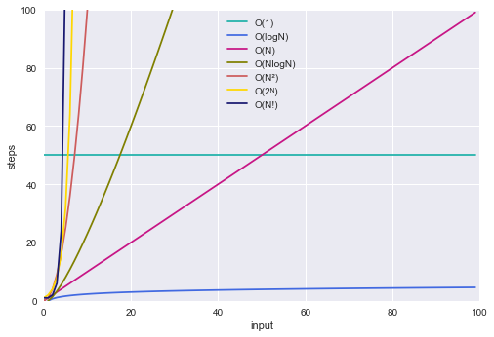
A rule of thumb

Slide 51
What about Merge sort?
For a list of size n, splitting things up (first step) requires roughly n EO.
Then, we repeat some times a merging process, swapping at most once each element, so, each merging sequence requires (at most) n EO.
But, how many times we repeat those merging sequences?
[Take some time to think…]
If we have 8 elements in our list, we split once, (2 lists of 4), another once (4 lists of 2) and another once (8 lists of 1). So, three times.
8, 3, splitting in 2: How to combine all those?
2³ = 8 → 3 = log(8), where log is base-2 logarithm.
So, log(n) in the general case.
Overall: nlog(n) + n, which is O(nlog(n)).

Slide 52

Any Questions?
Don’t forget to fill-in the questionnaire! (check right)
https://forms.gle/zezKMVzhaT4xyJgk8

